Slide 1

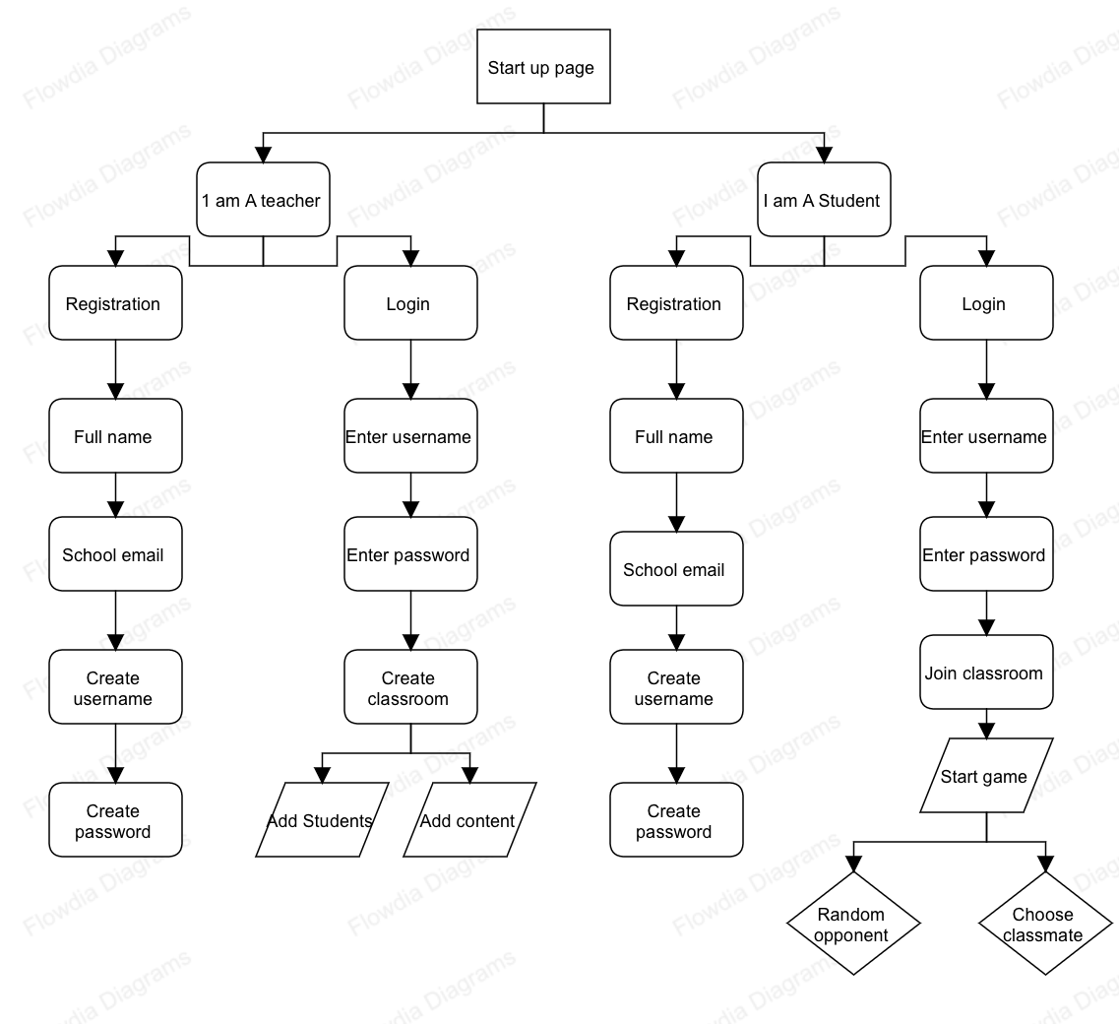
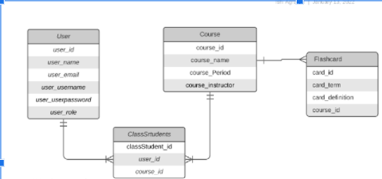
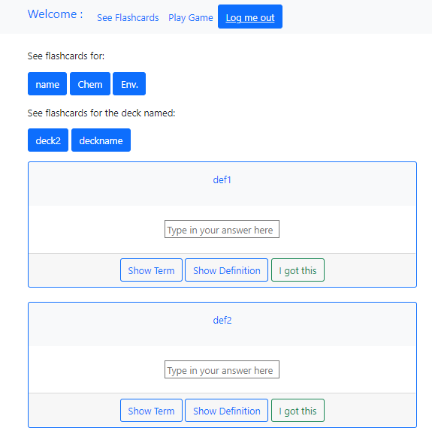
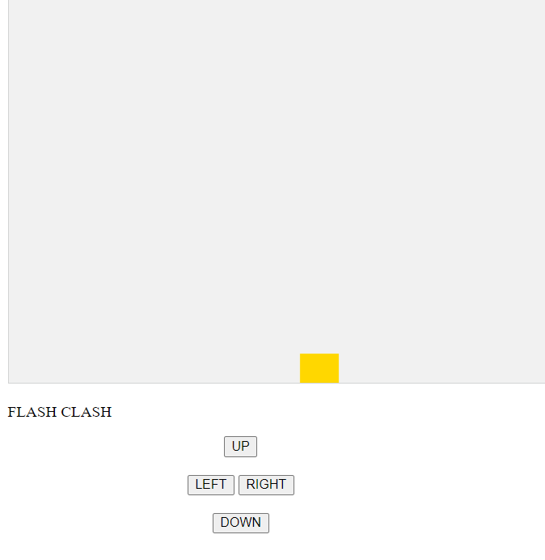


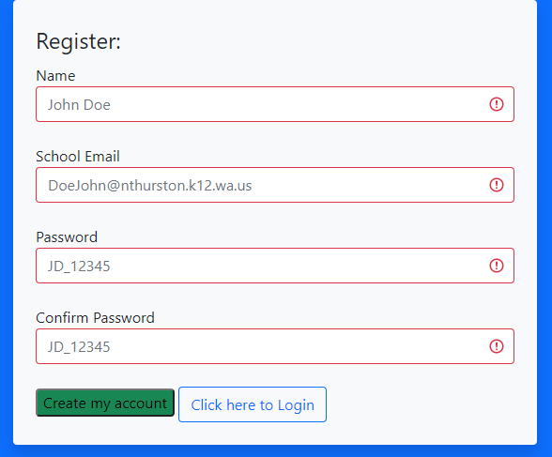
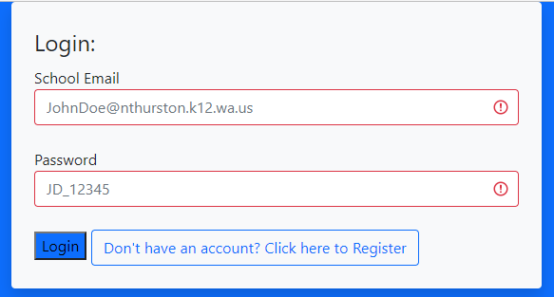
Saint Martin’s University: Senior Project 2021-2022
Hal and Inge Marcus School of Engineering: Department of Computer Science
Flash Clash-Flashcard Study Application
Team Members: Tedy Barber (Project Manager/Software Developer), Ishi Agrawal (Client Point of Contact/Lead Software Developer), Dominique Bornilla (Lead Game Developer)
Advisor: Dr. Nelson
Project Summary:
Student Work:
The objective of the project is to create a web application that helps students study with flashcards created by their teachers. Our application aims to combine the popular flashcard and study sites, Quizlet and Kahoot, for a better and more efficient learning experience.
Features:
Create, edit, and delete a study set of flashcards
Register users via their school information only
Create classrooms with all registered students from each section of the teachers’ classes
Individual study options
Study game feature
Tools:
Heroku Postgres
HTML/CSS/JS/PHP
Fig. 1: Flow Chart of Application
Fig. 2: ER Diagram of Application
Fig. 3: Flashcard Review Page
Fig. 4: Flash Clash Start-up Page
Fig. 5: Registration/Login Page
Sponsor/Client: Timothy Koontz , Timberline High School

